Slide 1


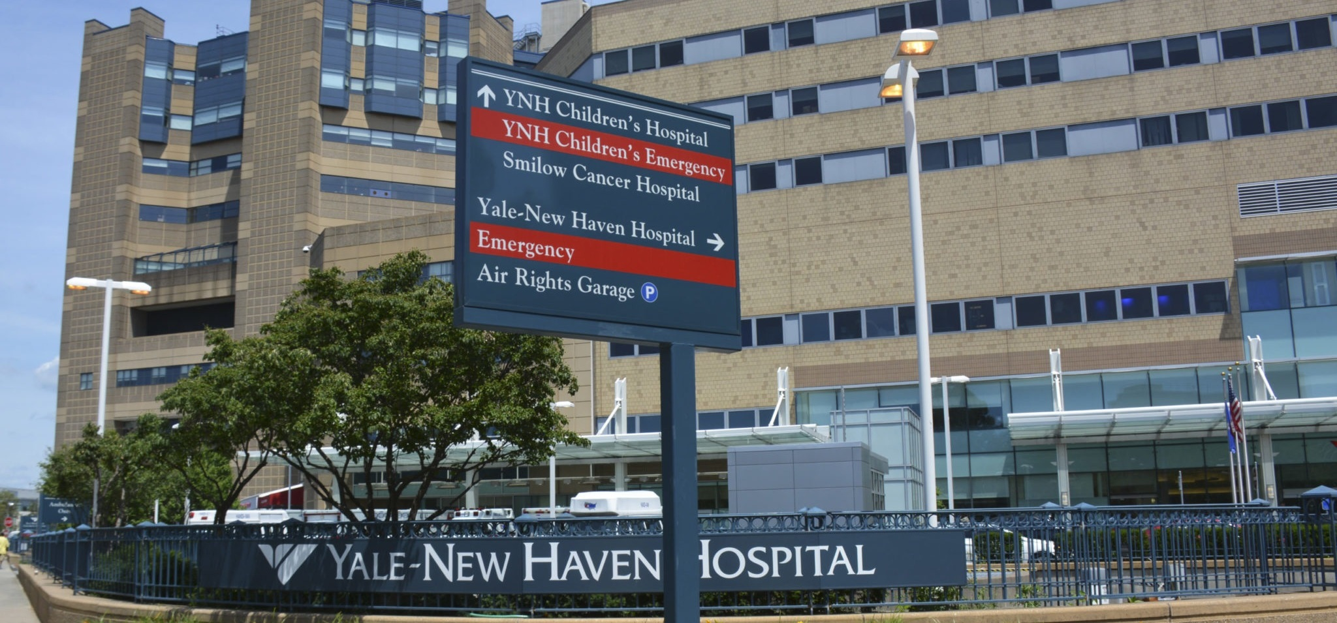
YALE NEW HAVEN HEALTH SYSTEM DIRECT-TO-EMPLOYER PLAN
November 21, 2024

Slide 2



Founded in 1979 and headquartered in Indianapolis, IN​
Full-service TPA specializing in the administration of self-funded health plans and population health management​
One of the country’s largest independently-owned TPAs
The Key Family is a commonly-held group of benefits related organizations with:​
3,000+ corporate clients​
3.0 million members under management​
700 Employees
Exclusive Relationships
We know The Market – Agents, Networks, and MGAs

Slide 3


Market Leader in Private Labeled DTE Plans
Louisville, KY
OneHealth Plan
Cincinnati, OH
TCH Optimal
Bentonville, AR
Northwest Health Plan
Knoxville, TN
East Tennessee Health Plan
Meridian, MS
Affinity Health Plan
Fort Myers, FL
Lee Health Care Partners

Slide 4
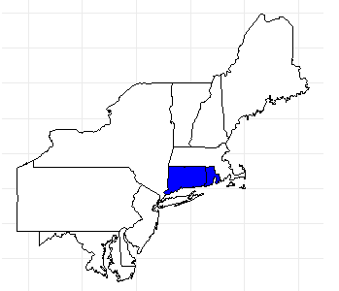
Significant Opportunity for Plan Growth Researched for Connecticut and Rhode Island
Target Market 5,000+ Employers 1,500,000+ Employees 2,000,000+ Members
 | Employer Size Group (# of Employees)
Commercial Employers With Headquarters | 50-100 | 101-200 | 201-400 | 401-1,000 | 1,001-3,000 | 3,000+
In Catchment Area | 3,754 | 1566 | 905 | 537 | 171 | 141
Total Employees at Employers | 50-100 | 101-200 | 201-400 | 401-1,000 | 1,001-3,000 | 3,000+
Headquartered in Catchment Area | 281,600 | 234,900 | 271,500 | 375,900 | 342,000 | 846,000
Total Members with Employers | 50-100 | 101-200 | 201-400 | 401-1,000 | 1,001-3,000 | 3,000+
Headquartered in Catchment Area | 506,900 | 422,800 | 488,700 | 676,600 | 615,600 | 1,522,800

Slide 5
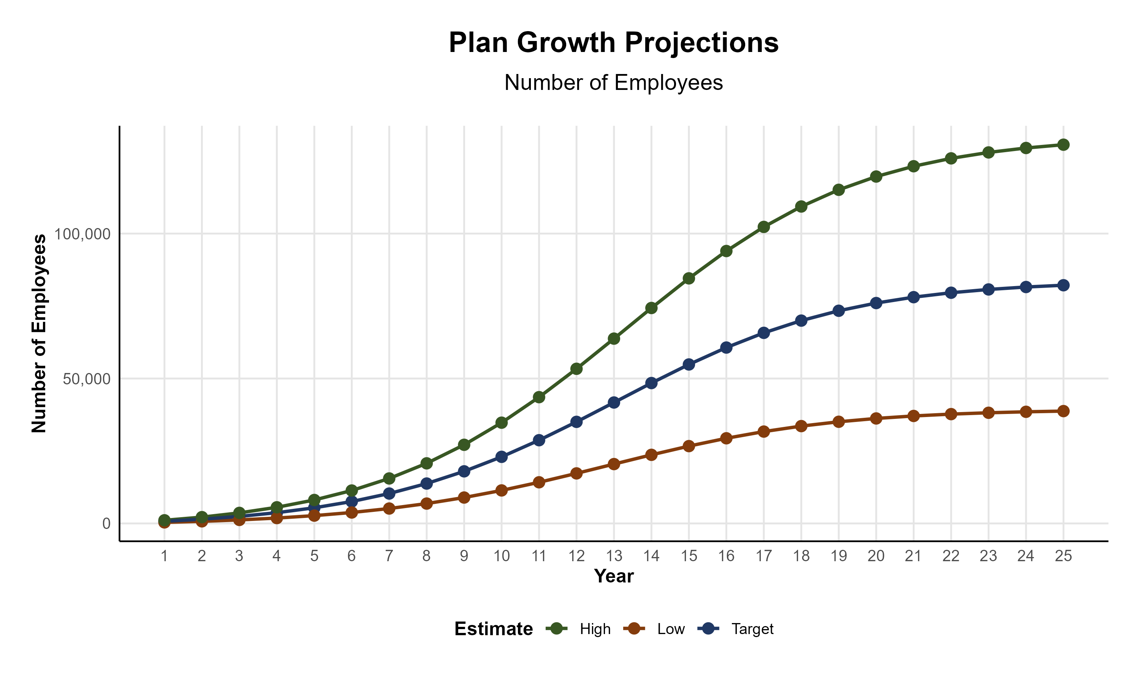
Plan Potential Growth Paths
Self Funded
1,090K
PLAN GROWTH POTENTIAL
2,033K
Insured
Working Age
2,827K
Population
4,706K
Estimates include Connecticut and Rhode Island

Slide 6

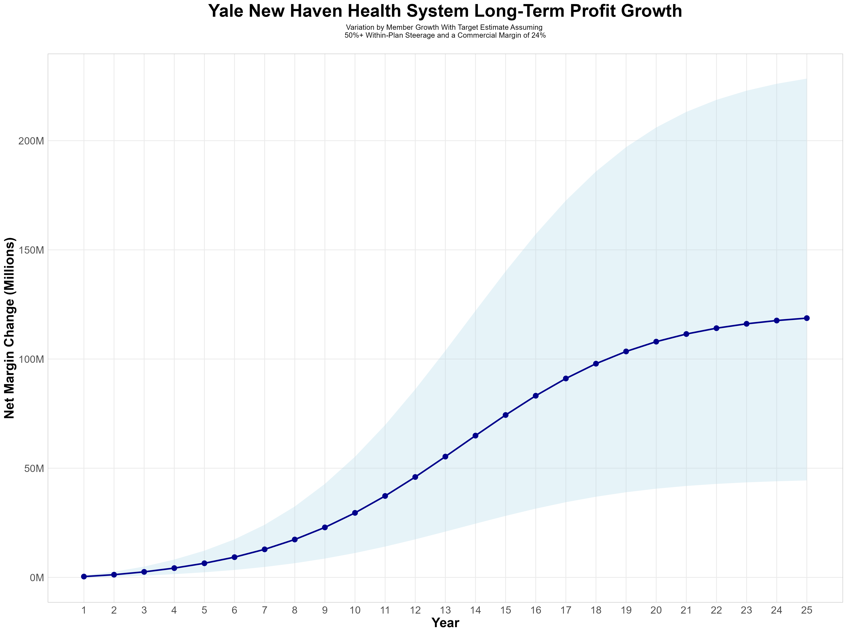
Growing Powerful, Lasting Profitability
Early Stage
Gaining Name Recognition, Early Growth
New Revenue:
New Profit:
$29.53M
$6.79M
Growth Stage
Strong Reputation, Strong Growth
New Revenue:
New Profit:
$219.56M
$51.69M
Mature Stage
High Profitability, Market Saturation
New Revenue:
New Profit:
$461.5M
$108.72M

Slide 7
SINGLE YEAR SUMMARY
DTE Covered Members Financial Analysis | DTE Covered Members Financial Analysis | DTE Covered Members Financial Analysis | DTE Covered Members Financial Analysis | DTE Covered Members Financial Analysis | DTE Covered Members Financial Analysis | DTE Covered Members Financial Analysis | DTE Covered Members Financial Analysis
Target Estimate Assuming 50%+ Within-Plan Steerage and a Commercial Margin of 24%. | Target Estimate Assuming 50%+ Within-Plan Steerage and a Commercial Margin of 24%. | Target Estimate Assuming 50%+ Within-Plan Steerage and a Commercial Margin of 24%. | Target Estimate Assuming 50%+ Within-Plan Steerage and a Commercial Margin of 24%. | Target Estimate Assuming 50%+ Within-Plan Steerage and a Commercial Margin of 24%. | Target Estimate Assuming 50%+ Within-Plan Steerage and a Commercial Margin of 24%. | Target Estimate Assuming 50%+ Within-Plan Steerage and a Commercial Margin of 24%. | Target Estimate Assuming 50%+ Within-Plan Steerage and a Commercial Margin of 24%.
DTE Members | Pre-DTE Revenue | Pre-DTE Margin | DTE Revenue | DTE Incr. Revenue | DTE Total Margin | DTE Incr. Margin | Net Margin Less DTE Fees
100 | $ 247K | $ 57K | $ 659K | $ 412K | $ 153K | $ 96K | $ -233K
500 | $ 1,234K | $ 286K | $ 3,293K | $ 2,059K | $ 764K | $ 478K | $ 154K
1,000 | $ 2,468K | $ 573K | $ 6,586K | $ 4,117K | $ 1,528K | $ 955K | $ 637K
2,500 | $ 6,171K | $ 1,432K | $ 16,464K | $10,293K | $ 3,820K | $ 2,388K | $ 2,088K
10,000 | $24,684K | $ 5,727K | $ 65,856K | $41,172K | $15,279K | $ 9,552K | $ 9,342K
20,000 | $49,368K | $11,453K | $131,712K | $82,344K | $30,557K | $19,104K | $19,014K
NOTE: Please see detailed financial analysis and assumptions used starting on page 25.
Financial projections do not include 340B contribution margin, which could represent $136 PMPM by optimizing 340B through Rx plan design, Yale New Haven Health System’s approved site(s) with network integration, and development of Yale New Haven Health System’s proprietary PBM program.

Slide 8
Year 4 Projected Revenue and Profit
Pre-DTE Cohort of 6,700 Employees | Inpatient | Outpatient | Professional | Total
Revenue† | $ 6,642,990 | $ 6,745,354 | $ 3,150,023 | $ 16,538,367
Net Income‡ | $ 1,541,174 | $ 1,564,922 | $ 730,805.3 | $ 3,836,901
† Assuming proportional revenues from market shares of 29% (inpatient) and 16% (outpatient)
‡ Conservatively assuming a commercial margin of 23.2% (80% of the estimated commercial margin)
With DTE | Inpatient | Outpatient | Professional | Total
Revenue⁰ | $ 15,260,202 | $ 23,914,011 | $ 11,167,640 | $ 50,341,853
Net Income* | $ 3,540,367 | $ 5,548,051 | $ 2,590,892 | $ 11,679,310
⁰ Assuming 67% inpatient and 58% market steerage based on KBA narrow network DTE experience (see previous slide)
* Conservatively assuming a commercial margin of 23.2%, with a 10 percentage-point reduction to reflect competitive-edge rates and a 10 percentage-point increase due to lower billing costs and higher patient responsibility collections because of the member credit card.
Total Increase in Net Income | $ 7,842,409
Network Access Fee (Revenue) of $1 PMPM | $ 80,400
Total Profit Growth | $ 7,847,209
Minus Implementation Fee (One-Time) | -$ 0
Minus Sales and Marketing (Annual – Ongoing) | -$ 180,000
Total | $ 7,742,809

Slide 9





A Partner You Can Trust
OUR OBJECTIVES ARE ALIGNED
WE KNOW THE
MARKET
COMPLETELY TRANSPARENT
WE HAVE THE SOPHISTICATION AND INFRASTRUCTURE TO EFFECTIVELY COMPETE
Derek Moore, Senior Vice President – KBA
845-283-9973 * derek.moore@keybenefit.com

